Slide 1
大学生线上失物招领&寻物启事综合平台
Lost & Found
汇报人：严永升

Slide 2
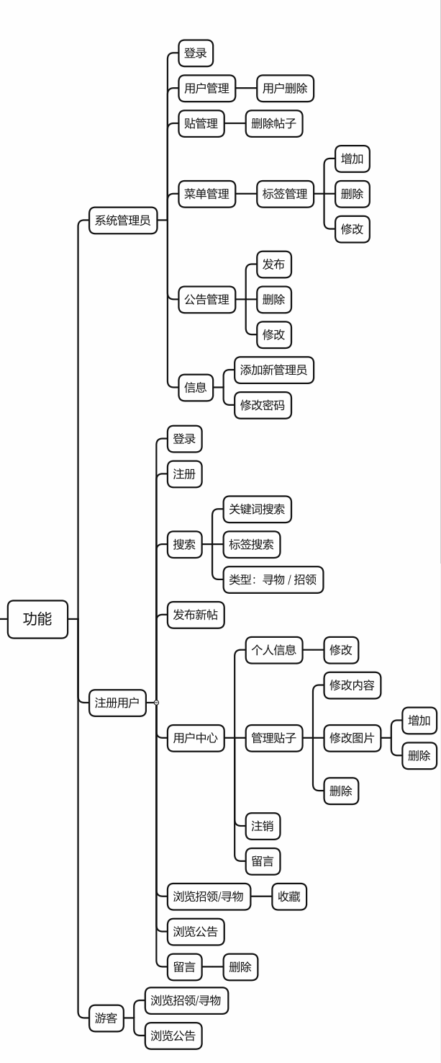
功能逻辑描述
大学生线上失物招领&寻物启事综合平台
Lost & Found
汇报人：airhaohan

Slide 3
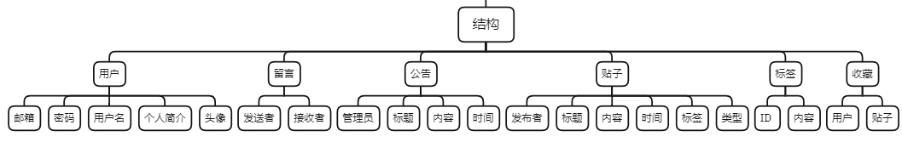
数据库描述
大学生线上失物招领&寻物启事综合平台
Lost & Found
数据库架构
用户：
账户：登录、注册、退出登录、注销
贴子：浏览、查看、发布、修改贴子
关注：收藏、取消收藏
个人中心：查看、修改个人信息
公告：查看公告
消息：查看消息列表、留言
管理员：
账户：修改密码、增加新管理员
用户：删除用户
标签：增加、修改、删除标签
公告：浏览、发布、修改、删除公告
贴子：浏览、查看、删除贴子
功能逻辑描述
汇报人：严永升

Slide 4
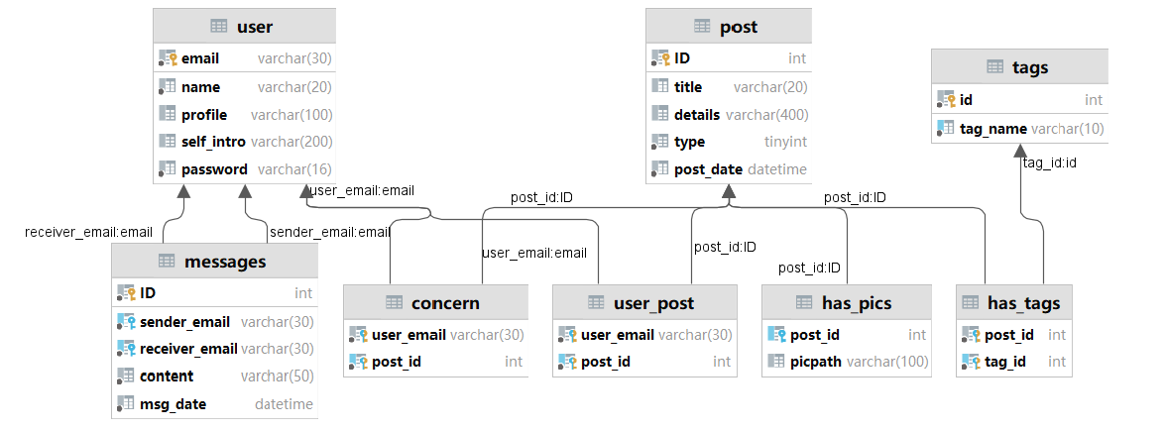
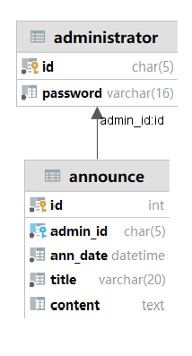
数据库描述
数据库架构
功能逻辑描述

Slide 5
数据库描述
三层架构
>>>>>>
数据库架构
要求
由于所有关系中每一关键字都不可再拆分，故满足1NF；
各关系中所有字段都依赖于主键（一个表仅描述一件事情），故满足2NF；
各关系中所有字段都于主键直接相关（仅仅依赖于主键），故满足3NF。
实体
user：用户信息，主键是 email
post：贴子信息，主键是 ID
tags：标签信息，主键是 ID
messages：留言，主键是 ID
admin：管理员信息，主键是 ID
announce：公告，主键是 ID
联系
concern：用户收藏，主键是 (user_email, post_id)（一对多）
user_post：用户发布，主键是 (user_email, post_id)（一对多）
has_pics：贴子对应的图片描述，主键是(post_id, pic_path)（一对多）
has_tags：贴子对应的标签，主键是(post_id, tag_id)（一对多）

Slide 6
三层架构
>>>>>>
1
2
3
持久层
DAO层
业务层
Service层
表现层
Web层
直接与数据库相连、完成和数据库交换内容，负责将数据持久化，实现对数据库的增删查改。
处理逻辑，连结DAO和Servlet；直接与项目中的需求挂钩，处理接口，将DAO层的函数转换为可以为Web层的业务逻辑直接使用的接口。
由 Servlet + JSP 实现；Servlet负责处理用户的操作逻辑，通过调用Service的方法实现；JSP负责前端展示，向Servlet发出请求；

Slide 7
2
业务层
Service层
处理逻辑，连结DAO和Servlet；直接与项目中的需求挂钩，处理接口，将DAO层的函数转换为可以为Web层的业务逻辑直接使用的接口。
Web层
Servlet：前端请求与反馈
JSP / HTML + CSS：Materialize -> 样式
JavaScript：jQuery -> 前端逻辑
JavaBean：将实体数据封装，在Servlet和JSP页面之间传递
JSONUtil：GSON，异步传输时，将数据序列化
技术栈
Service层
基于http的远程调用；调用Dao层的对象实例与数据库进行内容交换
DAO层
JDBCUtil：单例模式，保存一个静态的Connection，简化数据库连接和关闭
JDBC：为客户端程序提供访问数据库的应用程序接口
三层架构
>>>>>>
1
3
代码结构
持久层
DAO层
表现层
Web层
直接与数据库相连、完成和数据库交换内容，负责将数据持久化，实现对数据库的增删查改。
由 Servlet + JSP 实现；Servlet负责处理用户的操作逻辑，通过调用Service的方法实现；JSP负责前端展示，向Servlet发出请求；

Slide 8
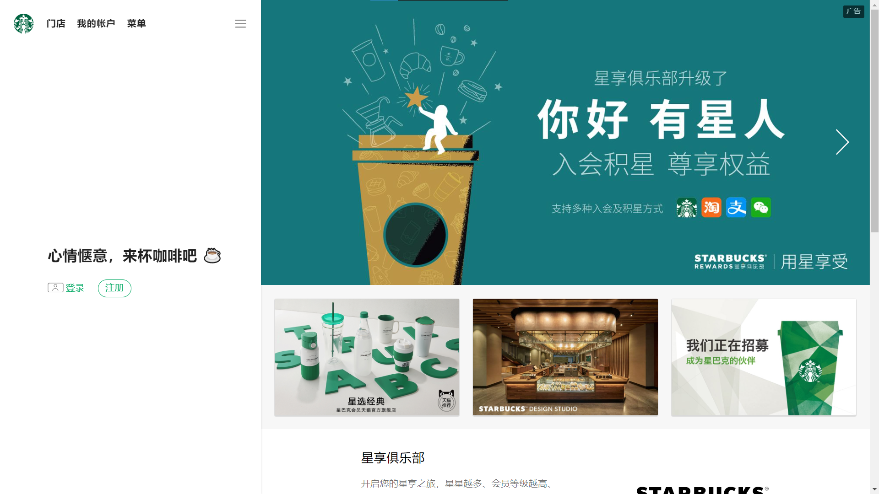
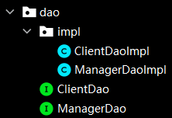
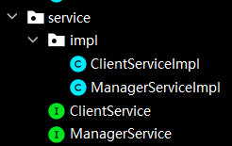
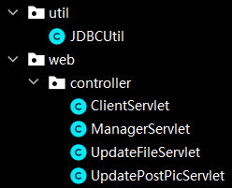
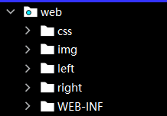
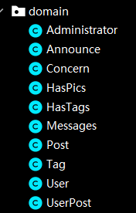
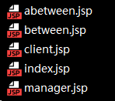
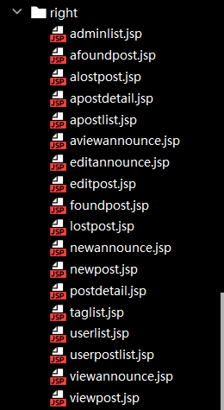
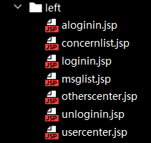
“UI设计”
DAO层
Service层
Web层
实体的封装
代码结构

Slide 9
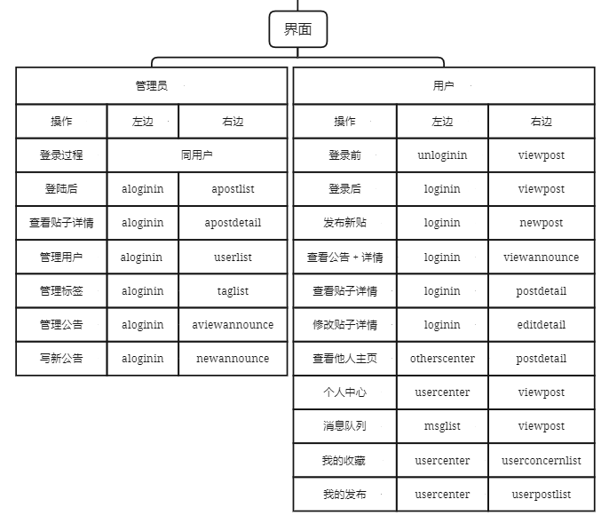
“UI设计”
代码结构

Slide 10
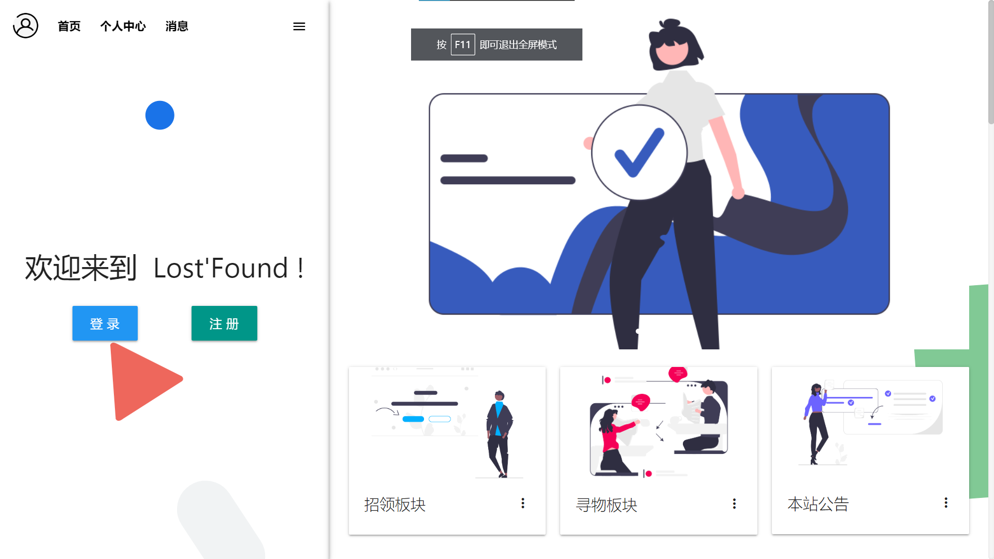
“UI设计”

Slide 11
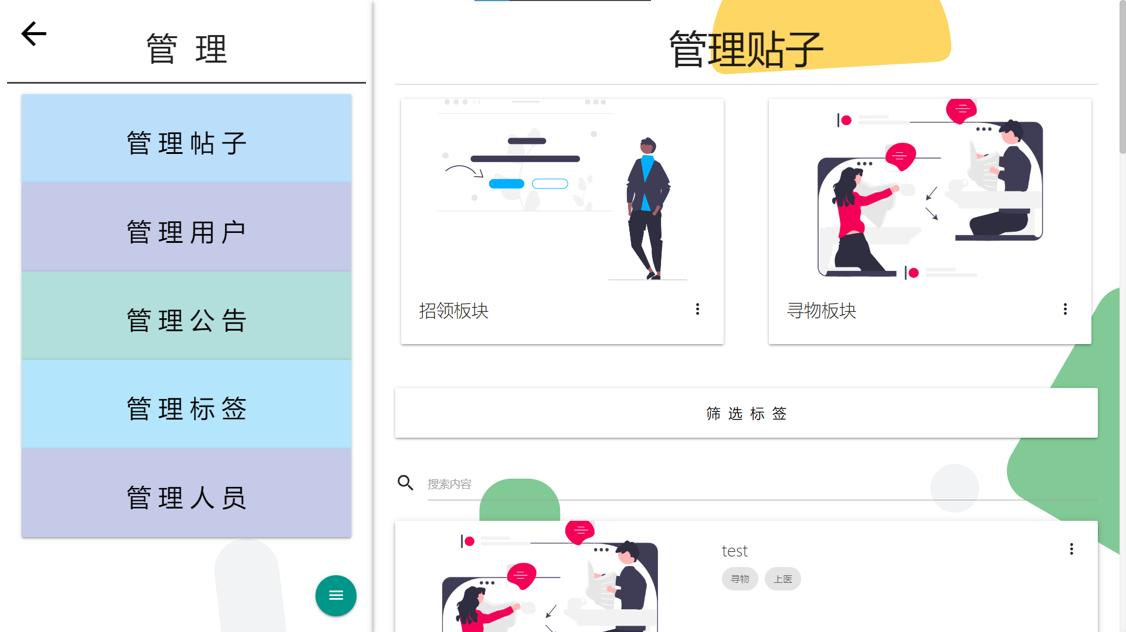
“UI设计”

Slide 12
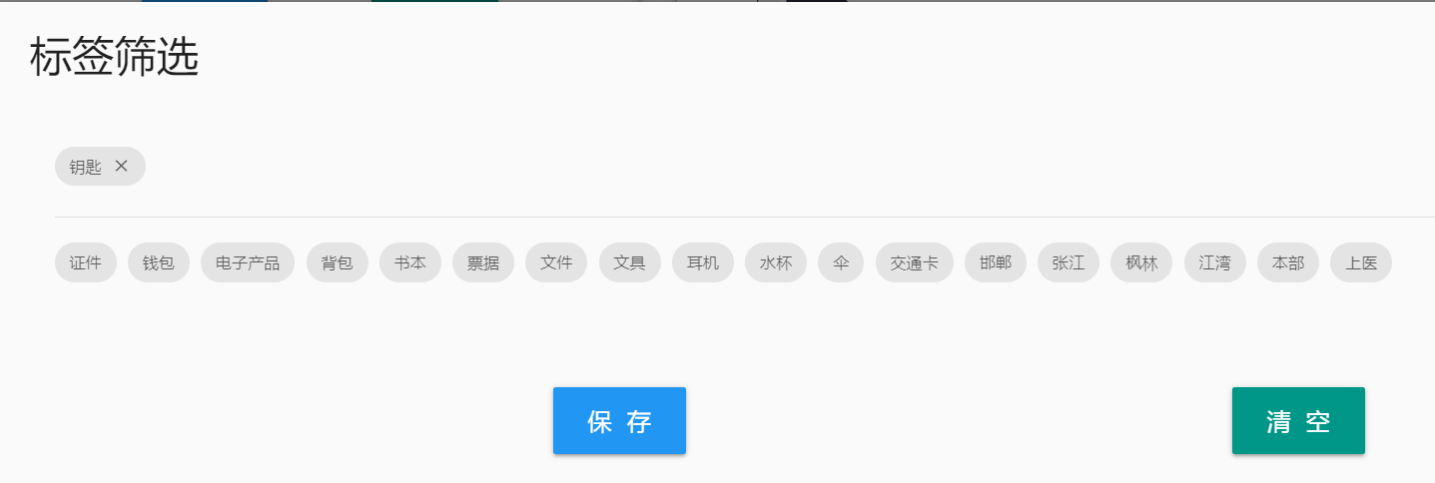
Web层(HTML)
“UI设计”
标签筛选

Slide 13
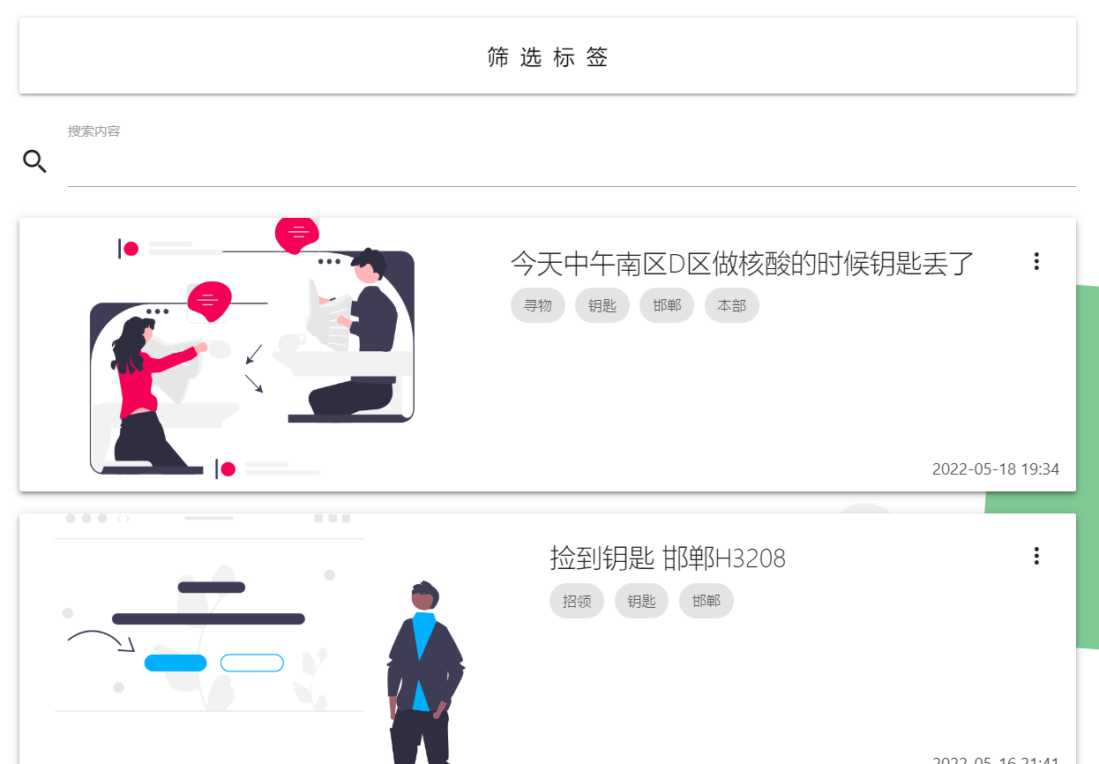
Web层(HTML)
“UI设计”
标签筛选

Slide 14
// init tags logic
var ses = document.querySelectorAll(".se i"); var uns = document.querySelectorAll(".un"); var che = document.querySelectorAll("input[type='checkbox']");
function getSelectedTags() { let url = "ClientServlet?op=getseltags"; $.get(url, function (data) { checkSelectedTags($.parseJSON(data)); }, "json"); } function checkSelectedTags(data) { console.log(data); for (let i = 0; i < data.length; ++i) { $("input[value='" + data[i] + "']").prop("checked", "true"); $("#se" + data[i]).removeClass("d-none"); $("#un" + data[i]).addClass("d-none"); } } getSelectedTags();
Web层(HTML)
标签筛选

Slide 15
private void getseltags (HttpServletRequest request, HttpServletResponse response) throws ServletException, IOException { HttpSession session = request.getSession(); request.setCharacterEncoding("UTF-8"); List<String> tagsselected = (List<String>) session.getAttribute("tagsselected"); String seltags = "["; for (int i = 0; i != tagsselected.size(); ++i) { seltags += "\"" + tagsselected.get(i) + "\""; if (i != tagsselected.size() - 1) seltags += ","; } seltags += "]"; Gson gson = new Gson(); String json = gson.toJson(seltags); response.setContentType("text/html;charset=UTF-8"); response.getWriter().write(json); }
// init tags logic
var ses = document.querySelectorAll(".se i"); var uns = document.querySelectorAll(".un"); var che = document.querySelectorAll("input[type='checkbox']");
function getSelectedTags() { let url = "ClientServlet?op=getseltags"; $.get(url, function (data) { checkSelectedTags($.parseJSON(data)); }, "json"); } function checkSelectedTags(data) { console.log(data); for (let i = 0; i < data.length; ++i) { $("input[value='" + data[i] + "']").prop("checked", "true"); $("#se" + data[i]).removeClass("d-none"); $("#un" + data[i]).addClass("d-none"); } } getSelectedTags();
Web层(JS)
标签筛选

Slide 16
String tagliststr = ""; for (int i = 0; i < tag_ids.size(); ++i) { tagliststr += tag_ids.get(i); if (i != tag_ids.size() - 1) tagliststr += ","; } PreparedStatement preparedStatement = connection.prepareStatement( "select * from post
where ID in (select post_id from has_tags where FIND_IN_SET(tag_id, ?))
order by post_date desc limit ?, 10;" );
preparedStatement.setString(1, tagliststr); preparedStatement.setInt(2, postBeginIdx);
private void getseltags (HttpServletRequest request, HttpServletResponse response) throws ServletException, IOException { HttpSession session = request.getSession(); request.setCharacterEncoding("UTF-8"); List<String> tagsselected = (List<String>) session.getAttribute("tagsselected"); String seltags = "["; for (int i = 0; i != tagsselected.size(); ++i) { seltags += "\"" + tagsselected.get(i) + "\""; if (i != tagsselected.size() - 1) seltags += ","; } seltags += "]"; Gson gson = new Gson(); String json = gson.toJson(seltags); response.setContentType("text/html;charset=UTF-8"); response.getWriter().write(json); }
Web层(Servlet)
标签筛选
// init tags logic
var ses = document.querySelectorAll(".se i"); var uns = document.querySelectorAll(".un"); var che = document.querySelectorAll("input[type='checkbox']");
function getSelectedTags() { let url = "ClientServlet?op=getseltags"; $.get(url, function (data) { checkSelectedTags($.parseJSON(data)); }, "json"); } function checkSelectedTags(data) { console.log(data); for (let i = 0; i < data.length; ++i) { $("input[value='" + data[i] + "']").prop("checked", "true"); $("#se" + data[i]).removeClass("d-none"); $("#un" + data[i]).addClass("d-none"); } } getSelectedTags();

Slide 17
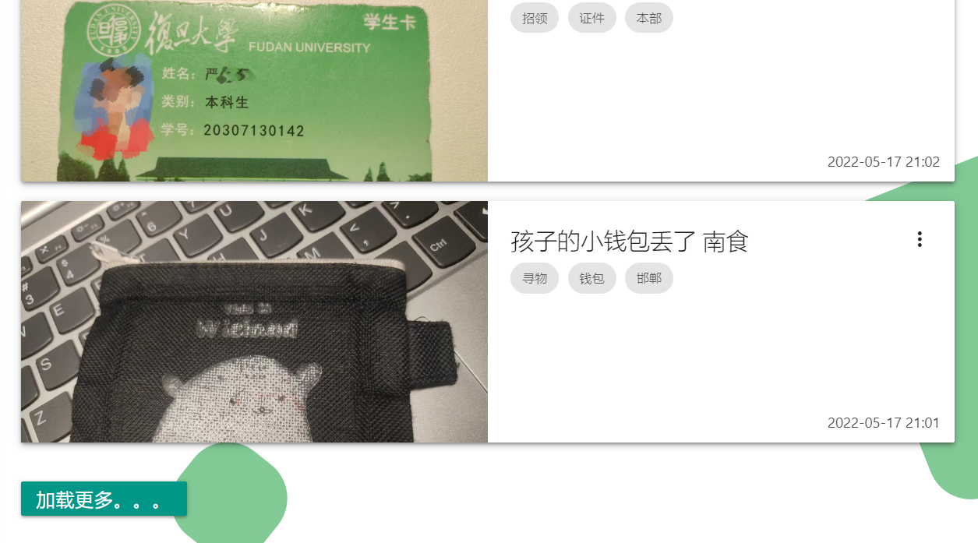
String tagliststr = ""; for (int i = 0; i < tag_ids.size(); ++i) { tagliststr += tag_ids.get(i); if (i != tag_ids.size() - 1) tagliststr += ","; } PreparedStatement preparedStatement = connection.prepareStatement( "select * from post
where ID in (select post_id from has_tags where FIND_IN_SET(tag_id, ?))
order by post_date desc limit ?, 10;" );
preparedStatement.setString(1, tagliststr); preparedStatement.setInt(2, postBeginIdx);
DAO层(JDBC)
标签筛选
private void getseltags (HttpServletRequest request, HttpServletResponse response) throws ServletException, IOException { HttpSession session = request.getSession(); request.setCharacterEncoding("UTF-8"); List<String> tagsselected = (List<String>) session.getAttribute("tagsselected"); String seltags = "["; for (int i = 0; i != tagsselected.size(); ++i) { seltags += "\"" + tagsselected.get(i) + "\""; if (i != tagsselected.size() - 1) seltags += ","; } seltags += "]"; Gson gson = new Gson(); String json = gson.toJson(seltags); response.setContentType("text/html;charset=UTF-8"); response.getWriter().write(json); }
卡片流

Slide 18
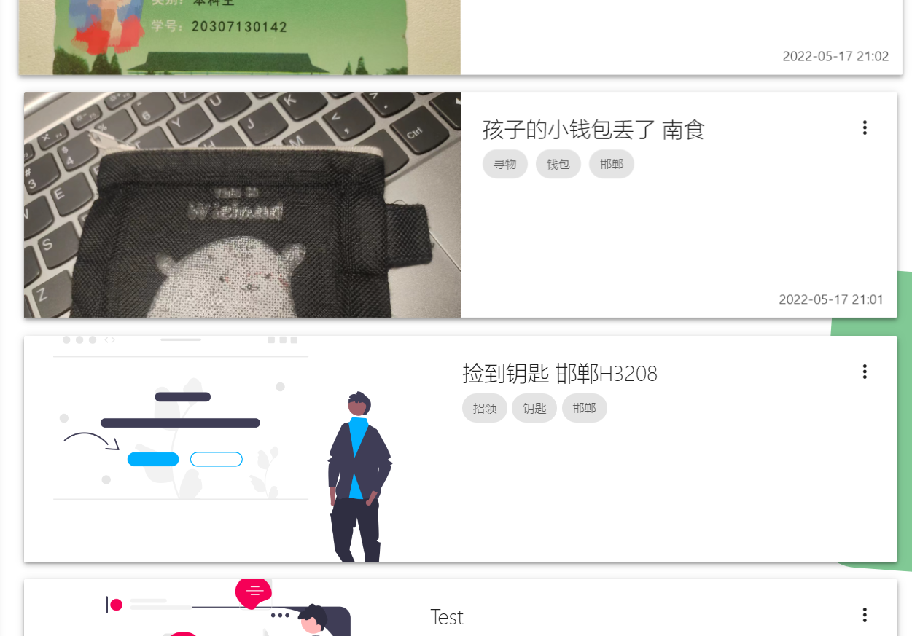
Web层(HTML)
卡片流
String tagliststr = ""; for (int i = 0; i < tag_ids.size(); ++i) { tagliststr += tag_ids.get(i); if (i != tag_ids.size() - 1) tagliststr += ","; } PreparedStatement preparedStatement = connection.prepareStatement( "select * from post
where ID in (select post_id from has_tags where FIND_IN_SET(tag_id, ?))
order by post_date desc limit ?, 10;" );
preparedStatement.setString(1, tagliststr); preparedStatement.setInt(2, postBeginIdx);
标签筛选

Slide 19
// load posts logic $("#loadMoreBtn").click(function () { getTenMorePosts(); }); let postBeginIdx = 10; function getTenMorePosts() { let url = "ClientServlet?op=gettenmoreposts&postBeginIdx=" + postBeginIdx; postBeginIdx += 10; console.log("click"); $.get(url, function (data) { addNewPost($.parseJSON(data)); }, "json"); } function addNewPost(data) { let len = data.length;
……
if (len < 10) { …… } $('.modal').modal(); }
Web层(HTML)
卡片流

Slide 20
private void gettenmoreposts(HttpServletRequest request, HttpServletResponse response) throws ServletException, IOException { HttpSession session = request.getSession(); int postBeginIdx = Integer.parseInt(request.getParameter("postBeginIdx")); List<Post> posts = new ArrayList<>(); List<String> tagsselected = (List<String>) session.getAttribute("tagsselected"); String searchword = (String) session.getAttribute("searchword"); if ((tagsselected == null || tagsselected.size() == 0) && (searchword == null || searchword.equals(""))) { posts = service.getTenPosts(postBeginIdx); } else if (searchword == null || searchword.equals("")) { posts = service.getTenTagsPost(postBeginIdx, tagsselected); } else { posts = service.getTenSearchTagsPost(postBeginIdx, searchword, tagsselected); } String postListStr = "["; for (int i = 0; i != posts.size(); ++i) { postListStr += posts.get(i).toString(); if (i != posts.size() - 1) postListStr += ","; } postListStr += "]"; Gson gson = new Gson(); String json = gson.toJson(postListStr); response.setContentType("text/html;charset=UTF-8"); response.getWriter().write(json); }
// load posts logic $("#loadMoreBtn").click(function () { getTenMorePosts(); }); let postBeginIdx = 10; function getTenMorePosts() { let url = "ClientServlet?op=gettenmoreposts&postBeginIdx=" + postBeginIdx; postBeginIdx += 10; console.log("click"); $.get(url, function (data) { addNewPost($.parseJSON(data)); }, "json"); } function addNewPost(data) { let len = data.length;
……
if (len < 10) { …… } $('.modal').modal(); }
Web层(JS)
卡片流

Slide 21
List<Post> getTenPosts(int postBeginIdx); // none filter List<Post> getTenTagsPost(int postBeginIdx, List<String> tag_ids); // tags filter List<Post> getTenSearchTagsPost(int postBeginIdx, String search, List<String> tag_ids); //search filter List<Post> getTenTypePosts(int postBeginIdx, int type); List<Post> getTenTypeTagsPost(int postBeginIdx, int type, List<String> tag_ids); // tags filter List<Post> getTenTypeSearchTagsPost(int postBeginIdx, int type, String search, List<String> tag_ids); //search filter
private void gettenmoreposts(HttpServletRequest request, HttpServletResponse response) throws ServletException, IOException { HttpSession session = request.getSession(); int postBeginIdx = Integer.parseInt(request.getParameter("postBeginIdx")); List<Post> posts = new ArrayList<>(); List<String> tagsselected = (List<String>) session.getAttribute("tagsselected"); String searchword = (String) session.getAttribute("searchword"); if ((tagsselected == null || tagsselected.size() == 0) && (searchword == null || searchword.equals(""))) { posts = service.getTenPosts(postBeginIdx); } else if (searchword == null || searchword.equals("")) { posts = service.getTenTagsPost(postBeginIdx, tagsselected); } else { posts = service.getTenSearchTagsPost(postBeginIdx, searchword, tagsselected); } String postListStr = "["; for (int i = 0; i != posts.size(); ++i) { postListStr += posts.get(i).toString(); if (i != posts.size() - 1) postListStr += ","; } postListStr += "]"; Gson gson = new Gson(); String json = gson.toJson(postListStr); response.setContentType("text/html;charset=UTF-8"); response.getWriter().write(json); }
Web层(Servlet)
卡片流
// load posts logic $("#loadMoreBtn").click(function () { getTenMorePosts(); }); let postBeginIdx = 10; function getTenMorePosts() { let url = "ClientServlet?op=gettenmoreposts&postBeginIdx=" + postBeginIdx; postBeginIdx += 10; console.log("click"); $.get(url, function (data) { addNewPost($.parseJSON(data)); }, "json"); } function addNewPost(data) { let len = data.length;
……
if (len < 10) { …… } $('.modal').modal(); }

Slide 22
List<Post> getTenPosts(int postBeginIdx); // none filter List<Post> getTenTagsPost(int postBeginIdx, List<String> tag_ids); // tags filter List<Post> getTenSearchTagsPost(int postBeginIdx, String search, List<String> tag_ids); //search filter List<Post> getTenTypePosts(int postBeginIdx, int type); List<Post> getTenTypeTagsPost(int postBeginIdx, int type, List<String> tag_ids); // tags filter List<Post> getTenTypeSearchTagsPost(int postBeginIdx, int type, String search, List<String> tag_ids); //search filter
Service层
卡片流
private void gettenmoreposts(HttpServletRequest request, HttpServletResponse response) throws ServletException, IOException { HttpSession session = request.getSession(); int postBeginIdx = Integer.parseInt(request.getParameter("postBeginIdx")); List<Post> posts = new ArrayList<>(); List<String> tagsselected = (List<String>) session.getAttribute("tagsselected"); String searchword = (String) session.getAttribute("searchword"); if ((tagsselected == null || tagsselected.size() == 0) && (searchword == null || searchword.equals(""))) { posts = service.getTenPosts(postBeginIdx); } else if (searchword == null || searchword.equals("")) { posts = service.getTenTagsPost(postBeginIdx, tagsselected); } else { posts = service.getTenSearchTagsPost(postBeginIdx, searchword, tagsselected); } String postListStr = "["; for (int i = 0; i != posts.size(); ++i) { postListStr += posts.get(i).toString(); if (i != posts.size() - 1) postListStr += ","; } postListStr += "]"; Gson gson = new Gson(); String json = gson.toJson(postListStr); response.setContentType("text/html;charset=UTF-8"); response.getWriter().write(json); }

Slide 23
List<Post> getTenPosts(int postBeginIdx); // none filter List<Post> getTenTagsPost(int postBeginIdx, List<String> tag_ids); // tags filter List<Post> getTenSearchTagsPost(int postBeginIdx, String search, List<String> tag_ids); //search filter List<Post> getTenTypePosts(int postBeginIdx, int type); List<Post> getTenTypeTagsPost(int postBeginIdx, int type, List<String> tag_ids); // tags filter List<Post> getTenTypeSearchTagsPost(int postBeginIdx, int type, String search, List<String> tag_ids); //search filter
Service层
谢谢观赏
THANK YOU FOR WATCHING
<<<<<<
展示环节
>>>>>>
卡片流
汇报人：严永升

Slide 24
谢谢观赏
THANK YOU FOR WATCHING
汇报人：airhaohan

Slide 25
Backup

